Slide 1
Stock Take Consolidation

Slide 2
Flow
1. Create the Stock Take Document on the Inv Portal
Full : System will automatically add all items with 0 stock qty. The items that not scanned, will set as 0.
Partial : System will NOT add all items with 0 stock qty, user must scan the items.
2. Stock Gun - Start Stock Take
3. Stock Gun - Submit Stock Take / Cancel
4. Inv Portal -> Submit Stock Take Document
5. Inv Portal -> Approve Stock Take (Adjusted)

Slide 3
Stock Take

Slide 4
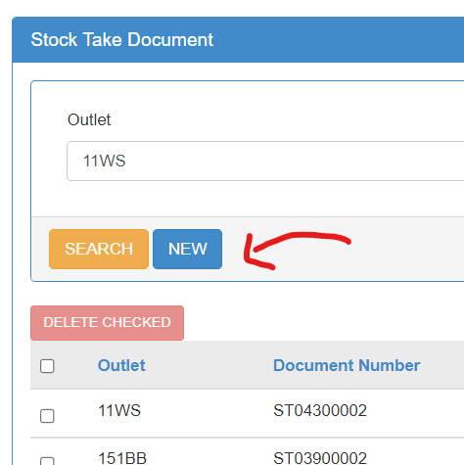
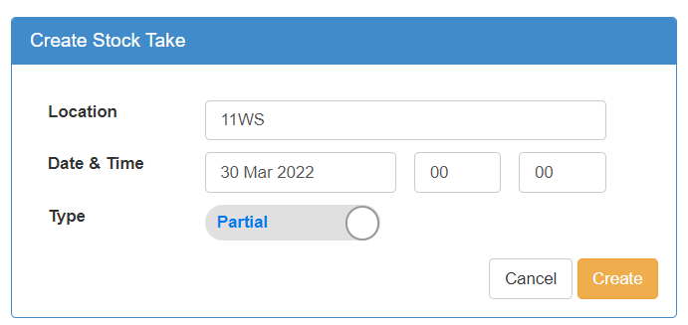
Create the Stock Take Document on the Inv Portal
Full : System will automatically add all items with 0 stock qty. The items that not scanned, will set as 0.
Partial : System will NOT add all items with 0 stock qty, user must scan the items.

Slide 5
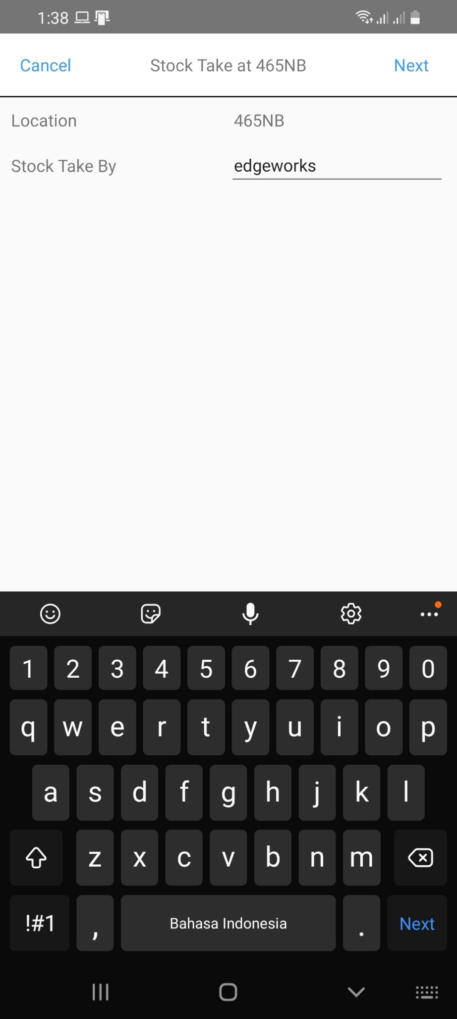
2. Start Stock Take
No need to fill date & time (will use server information)
Taken By will automatically filled with current login

Slide 6
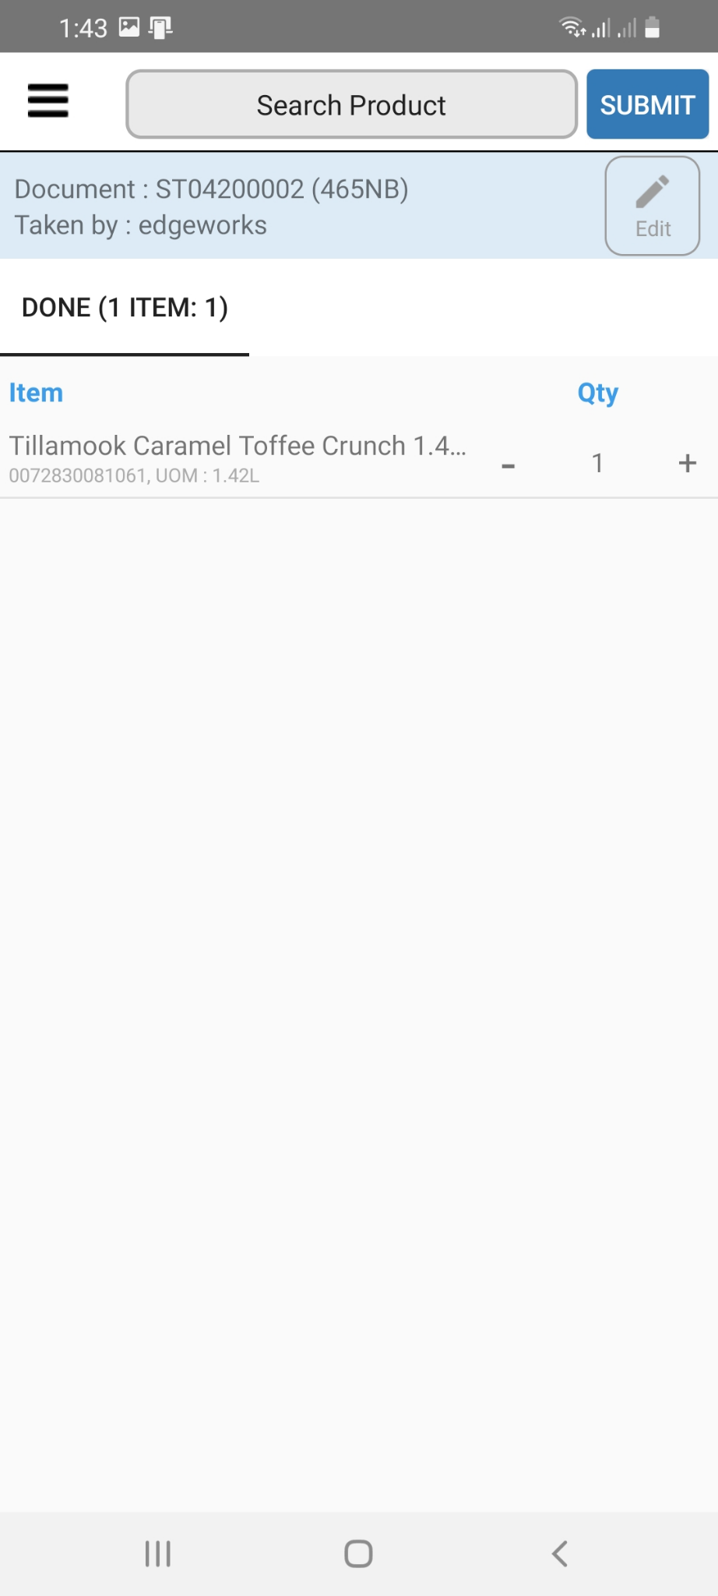
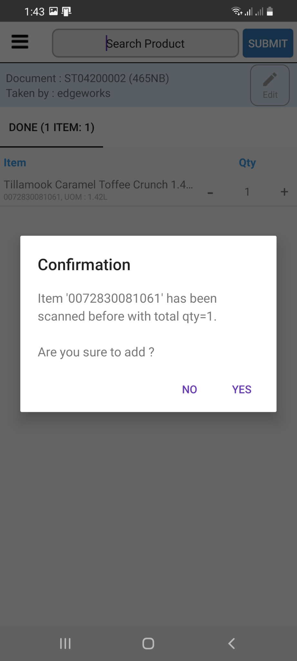
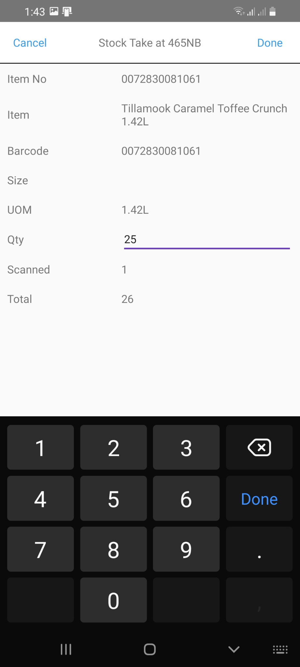
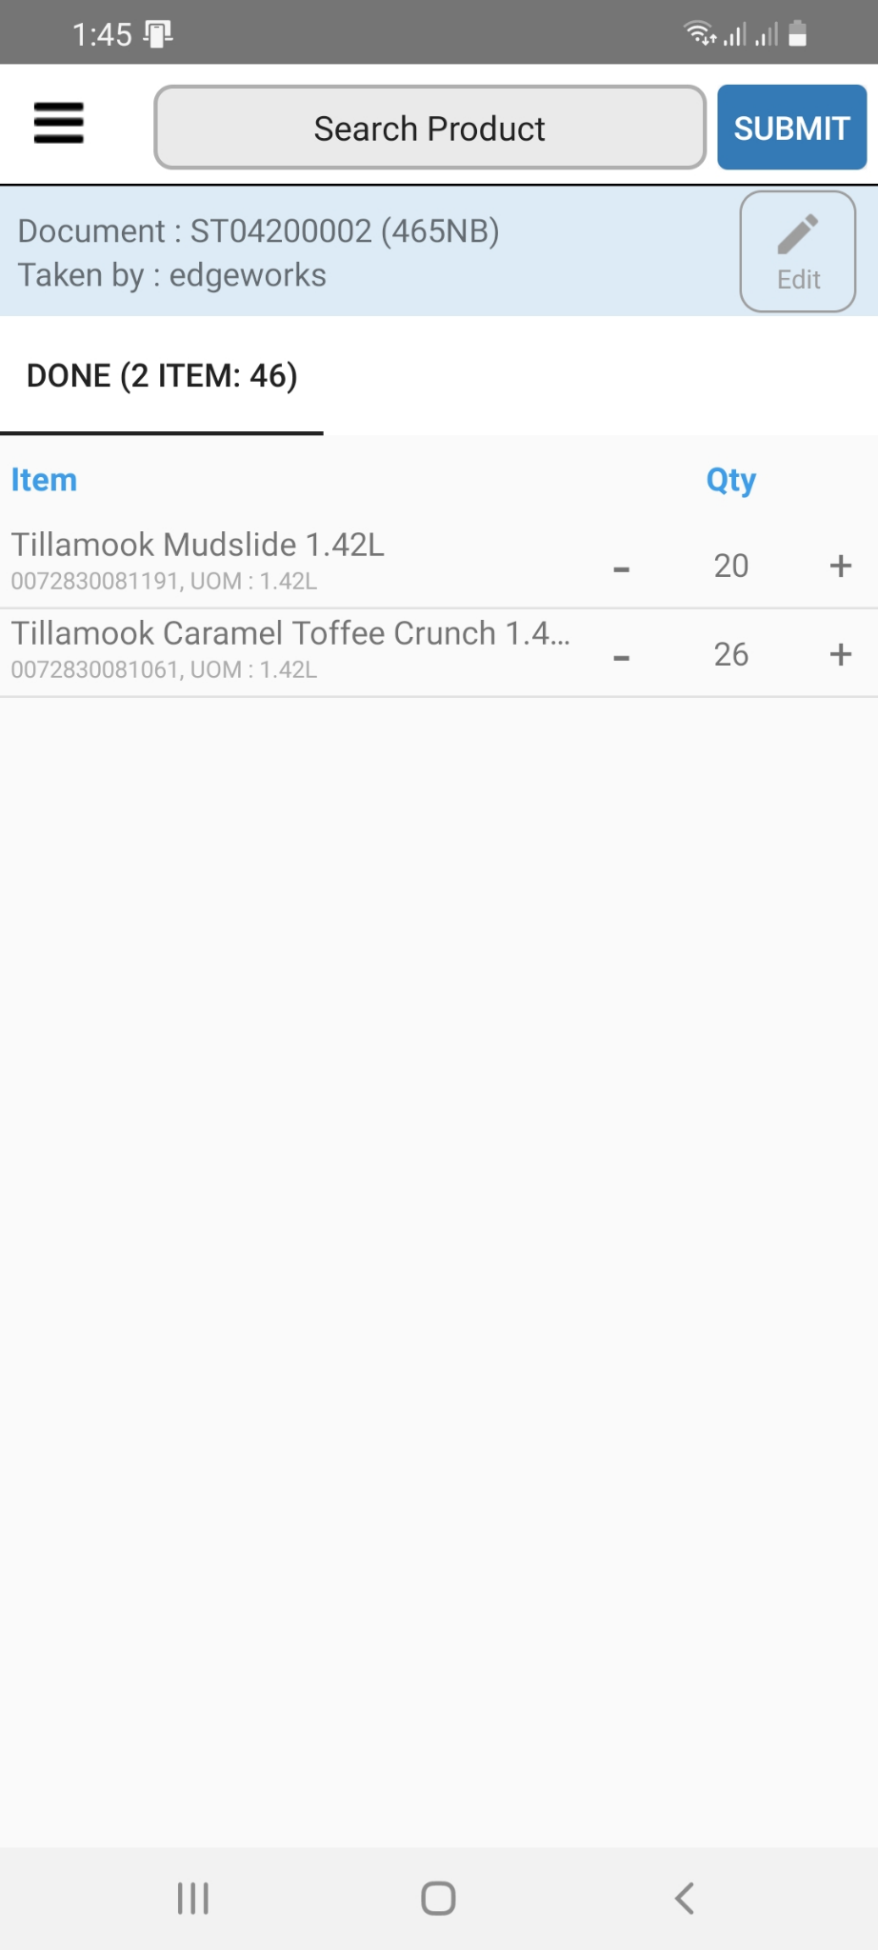
3. Scan Item

Slide 7
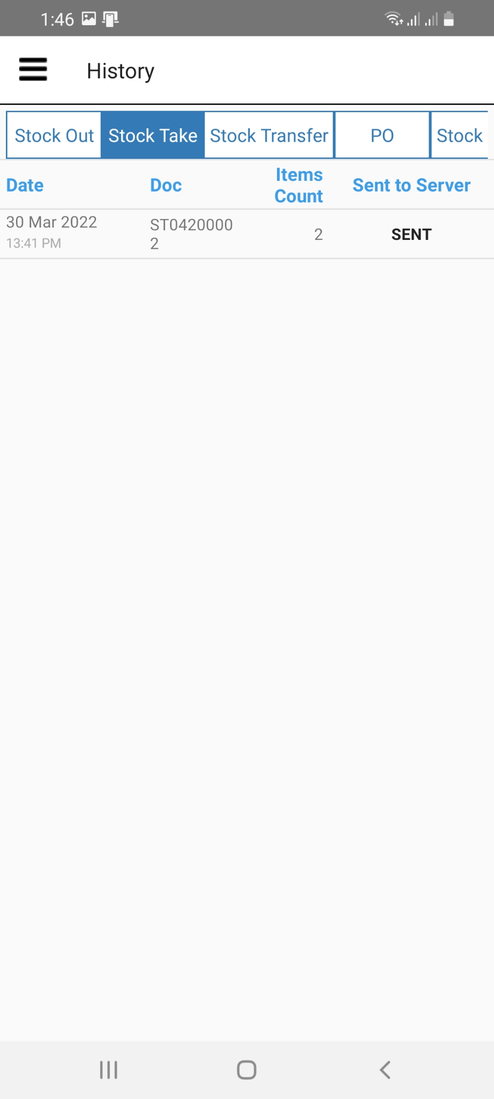
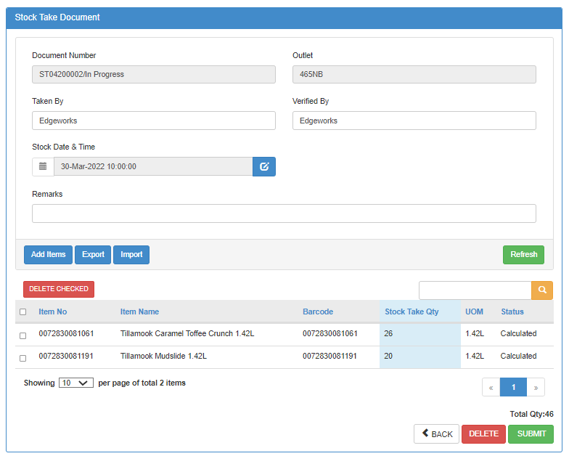
4. Submit Stock Take On Stock Gun

Slide 8
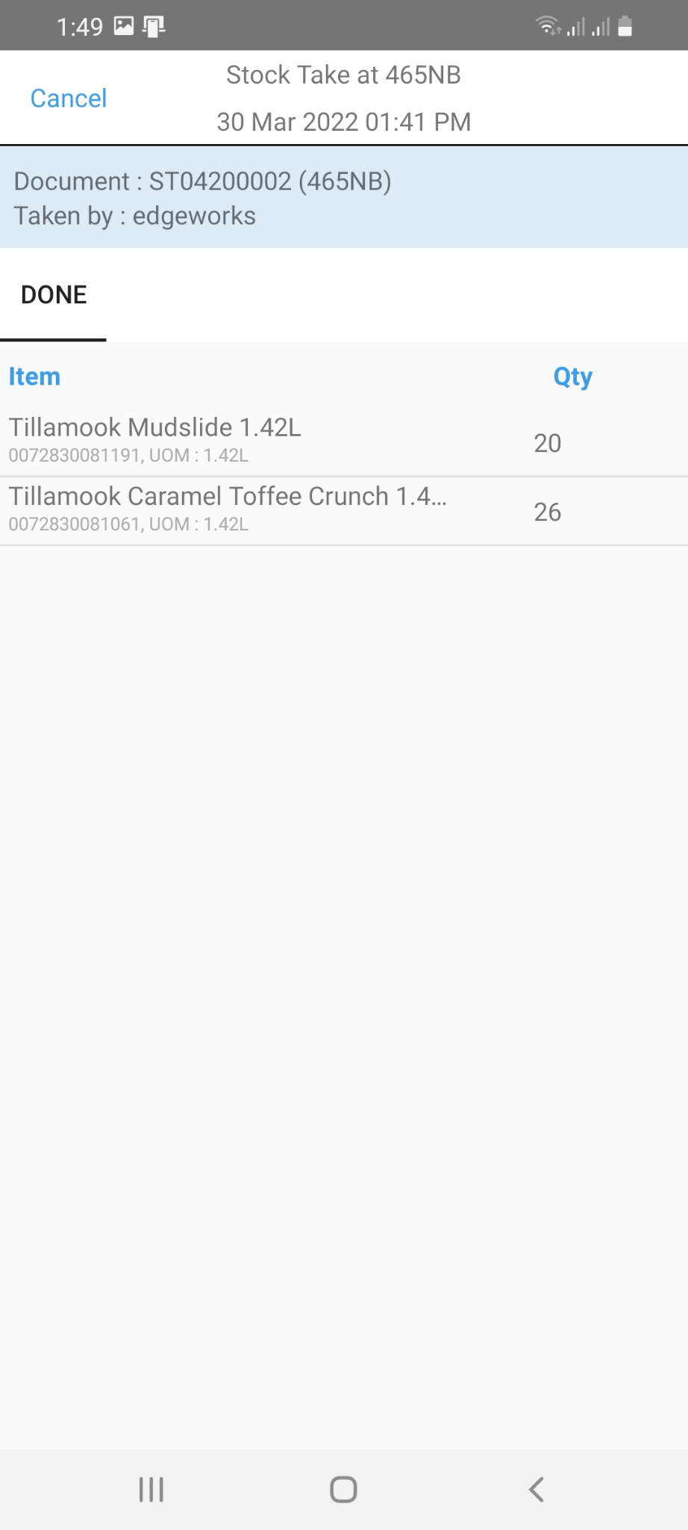
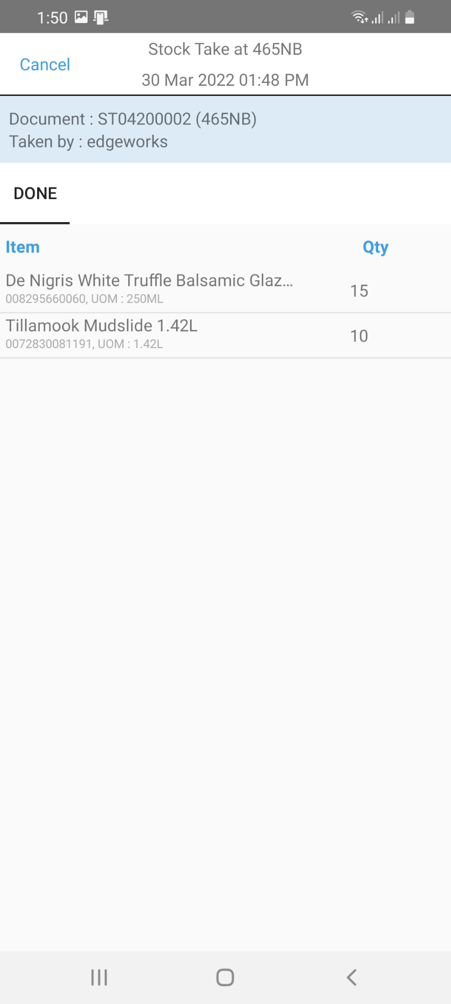
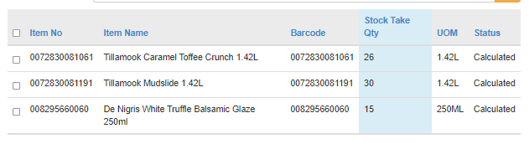
5. Submit for multiple stock gun, the qty will combined

Slide 9
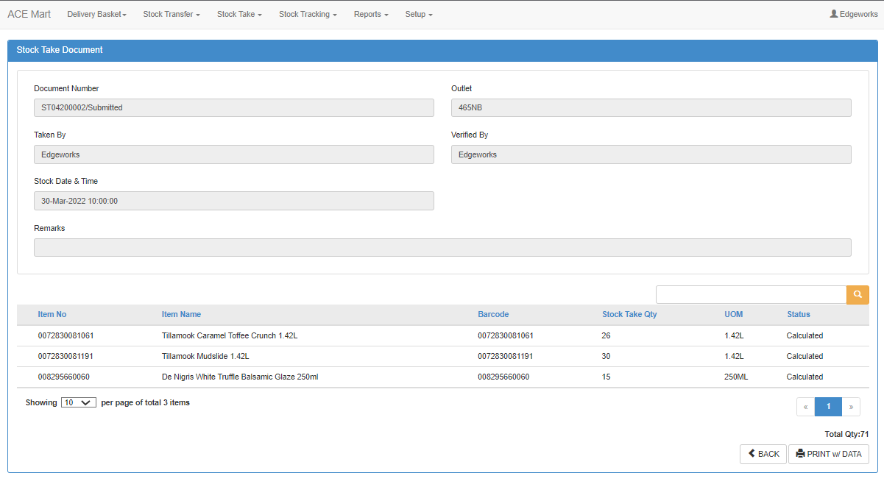
6. Submit stock take document at Inv Portal

Slide 10
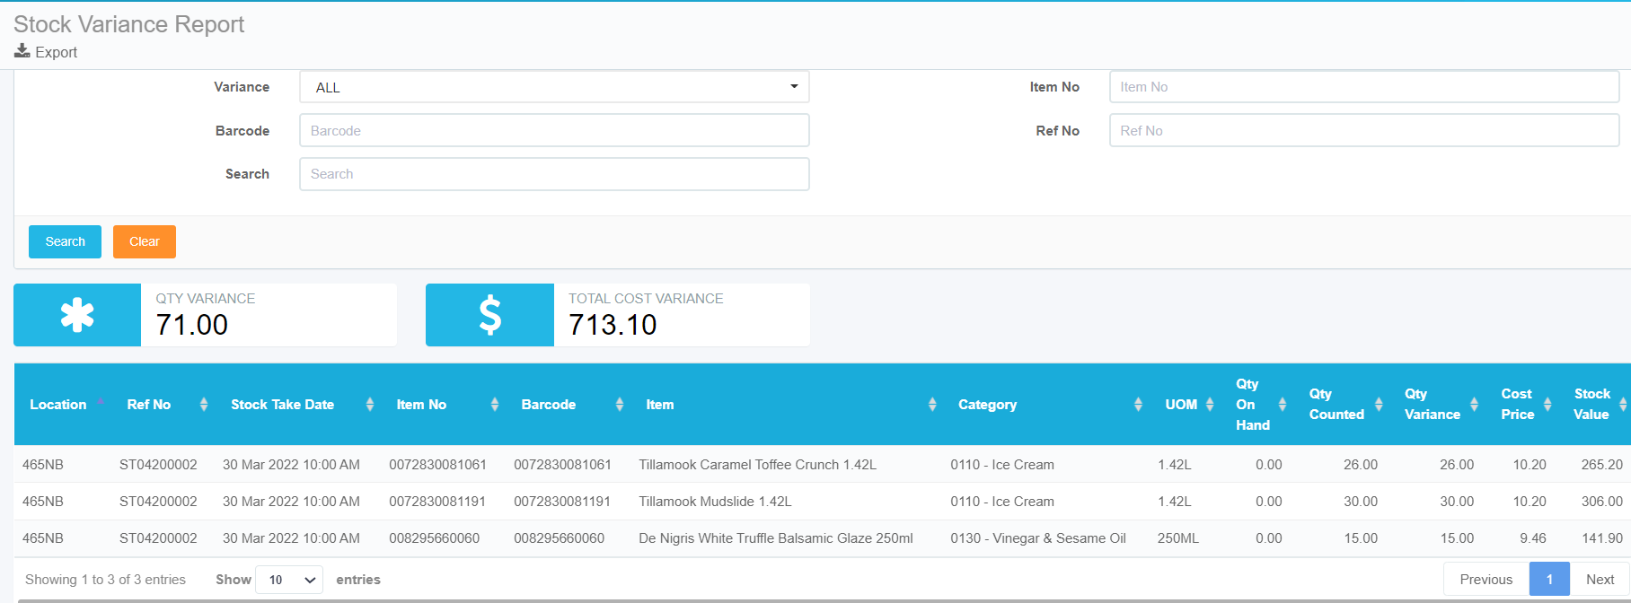
7. Review on stock variance report

Slide 11
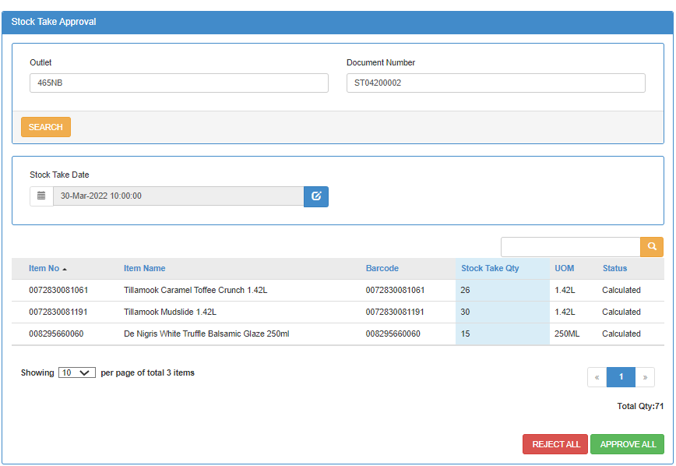
8. Approve Stock Take

Slide 12
If did not Approve Stock Take, all prevous Stock Take record will remain The past record will acumulate together
This is the 1st Stock Take
The 2nd Stock Take will combine the 1st Stock Take details

Slide 13
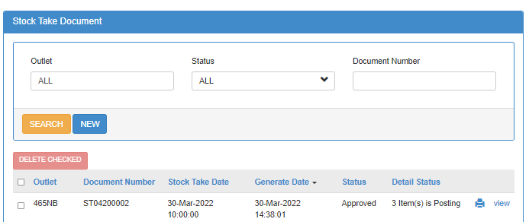

9. After Stock Take Approval
Posting = The system still doing adjustment
Posted = The balance adjustment already done

Slide 14
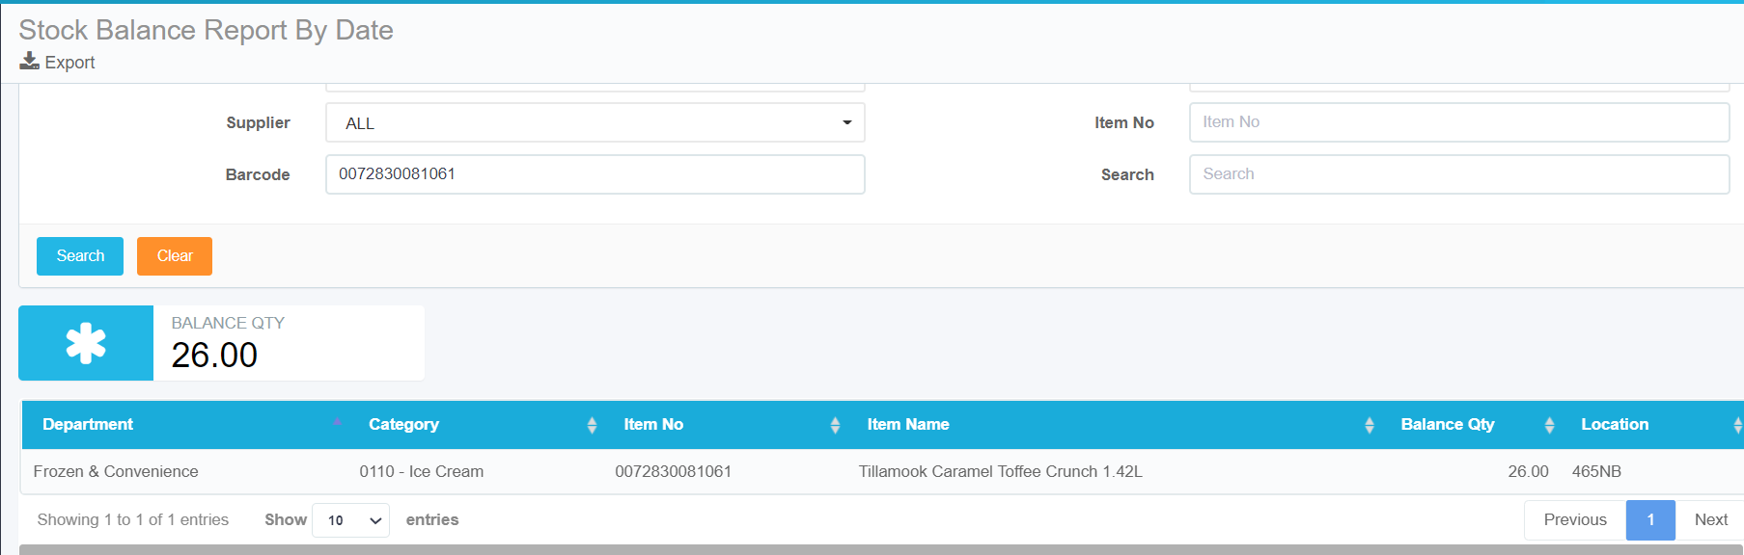
9. Stock On Hand By Date After Approval

Slide 15
After Approve Stock Take, you can create a new Stock Take

